Slide 1
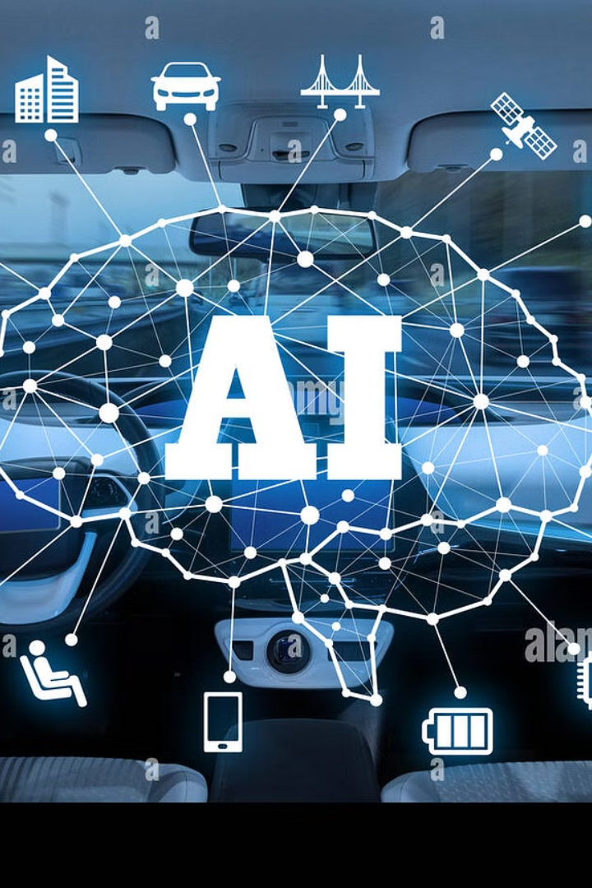

Introduction to Autonomous Vehicle Navigation
Explore the cutting-edge technology of autonomous vehicle navigation powered by artificial intelligence. Discover how AI-driven systems are revolutionizing the way we think about transportation and mobility.
1

Slide 2

Teammates
—
—
K. Abhishek
K.Harish kumar
~99220040562
~99220040566
—
—
K.Sai Vignesh Reddy
Y. Hari Krishna
~99220040561
~99220040779
2

Slide 3
Introduction
Autonomous vehicles rely on artificial intelligence to navigate. AI enables vehicles to perceive their environment, make decisions, and plan routes autonomously. The integration of AI in navigation systems has transformed transportation.
3

Slide 4
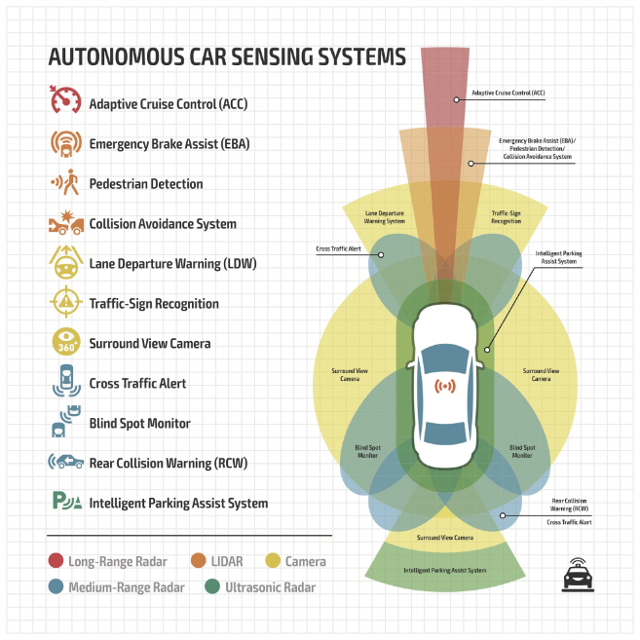
AI in Autonomous Vehicle Navigation
AI algorithms process data from sensors such as LiDAR, cameras, and GPS to understand the vehicle's surroundings.
Machine learning techniques enable autonomous vehicles to learn from past experiences and improve their navigation capabilities over time.
Deep learning models are used to interpret complex visual data for accurate decision-making.
4

Slide 5
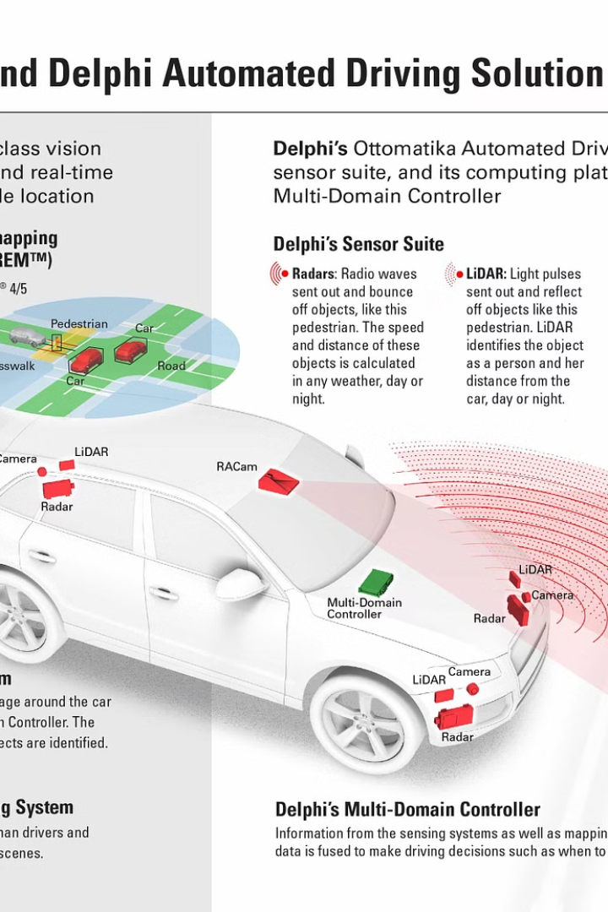
Perception and Sensing
Autonomous vehicles use sensor fusion to combine data from multiple sensors for a comprehensive understanding of the environment.
AI algorithms analyze sensor data to detect objects, recognize road signs, and identify obstacles in real-time.
Advanced perception systems enable autonomous vehicles to navigate safely in diverse and dynamic environments.
5

Slide 6
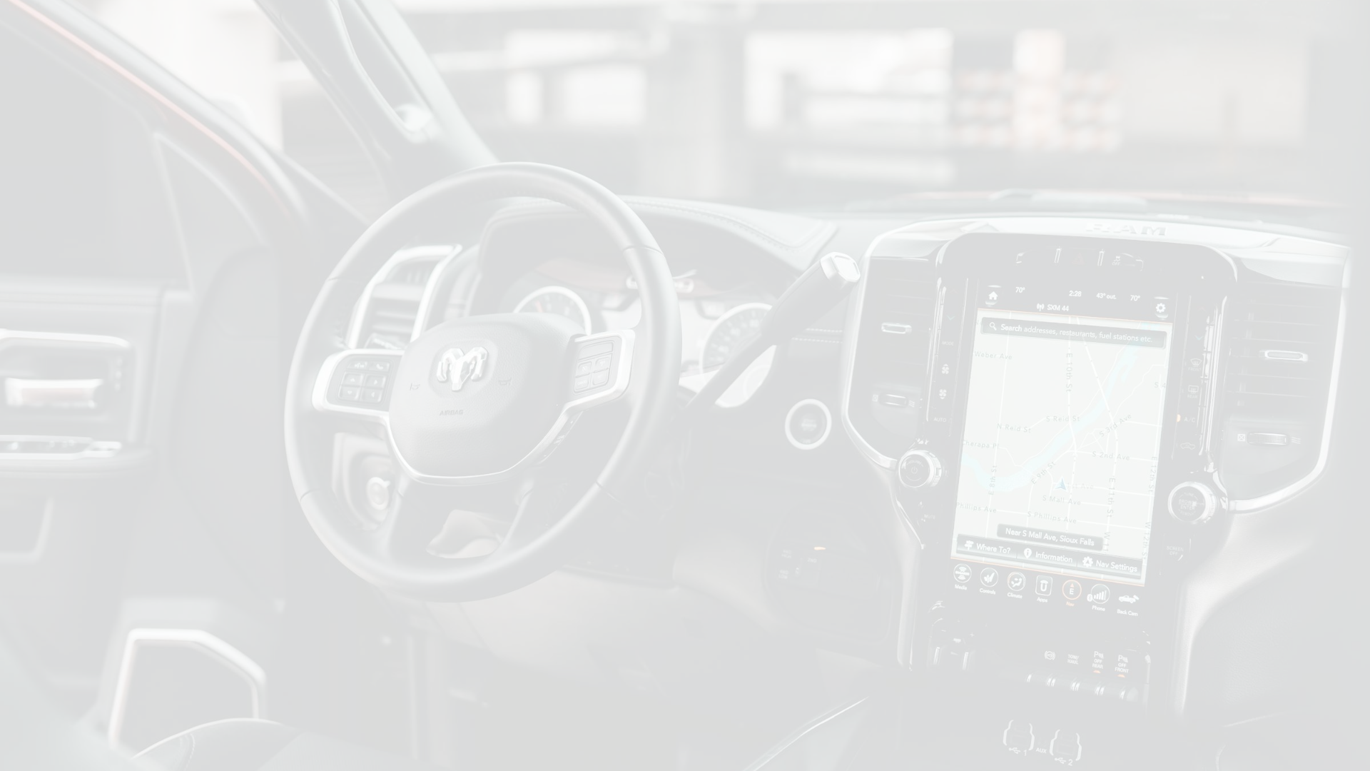



Decision-Making
Evaluate Factors
Adapt Behavior
Prioritize Safety
AI-powered decision-making algorithms evaluate various factors such as traffic conditions, pedestrian movements, and road infrastructure to make informed decisions.
Reinforcement learning techniques enable autonomous vehicles to adapt their behavior based on interactions with the environment.
Decision-making models prioritize safety, efficiency, and compliance with traffic rules.
6

Slide 7



Path Planning
Optimal Routes
1
Considering traffic, road conditions, and speed limits
Real-time Adjustments
2
Dynamically avoiding obstacles and optimizing travel time
Balanced Priorities
3
Safety, comfort, and efficiency
AI algorithms generate optimal routes for autonomous vehicles by considering factors like traffic congestion, road conditions, and speed limits. Real-time path planning adjusts routes dynamically to avoid obstacles and optimize travel time. Path planning systems aim to balance safety, comfort, and efficiency in autonomous vehicle navigation.
7

Slide 8
Localization and Mapping
Localization
1
AI-based techniques
SLAM
2
Mapping surroundings
High-precision Mapping
3
Enhances reliability
AI-based localization techniques help autonomous vehicles determine their position accurately within the environment. Simultaneous Localization and Mapping (SLAM) algorithms enable vehicles to create detailed maps of their surroundings while navigating. High-precision mapping enhances the reliability and robustness of autonomous vehicle navigation systems.
8

Slide 9


Implementation:
13

Slide 10


Implementation:
13

Slide 11
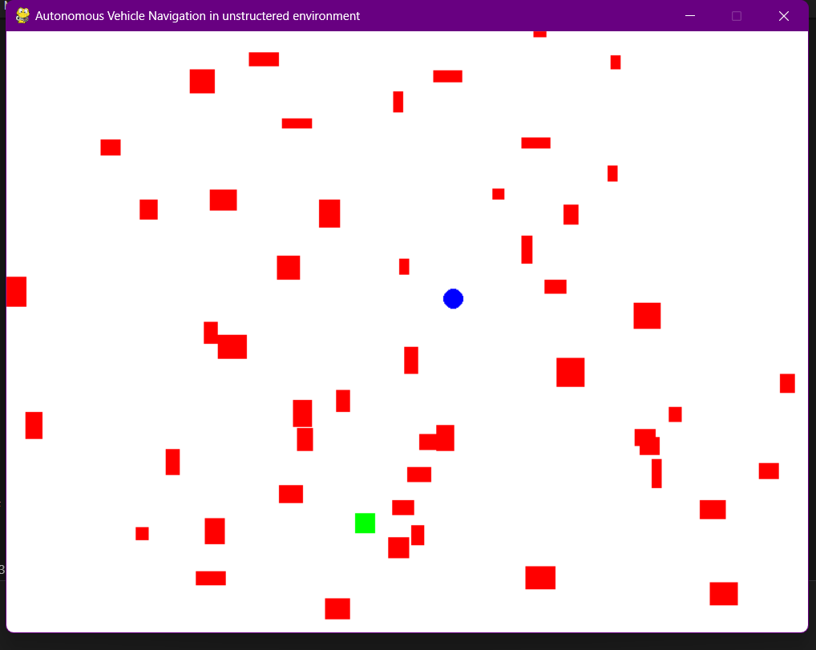
Outputs :
13

Slide 12
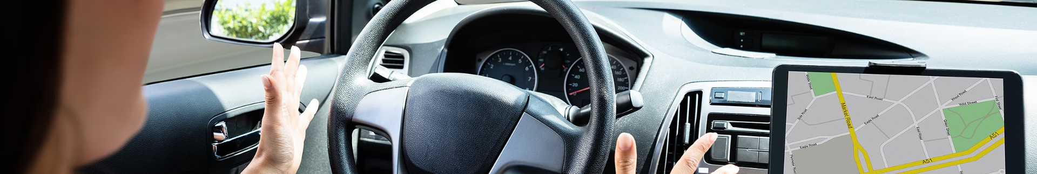
Challenges in Autonomous Vehicle Navigation
Handling Uncertainties
Cybersecurity Concerns
Regulatory and Ethical Considerations
AI systems in autonomous vehicles must handle uncertainties, such as unpredictable road conditions and human behavior.
Ensuring the cybersecurity of AI-powered navigation systems is crucial to prevent hacking and malicious attacks.
Regulatory and ethical considerations play a significant role in the deployment of autonomous vehicles on public roads.
10

Slide 13
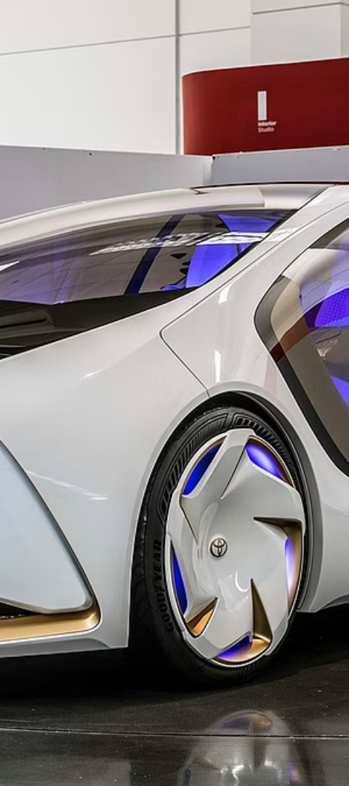
Future Trends
Emerging Technologies
Algorithmic Advancements
The integration of AI with other emerging technologies like 5G connectivity and edge computing will enhance the capabilities of autonomous vehicle navigation.
Continued research and development in AI algorithms and sensor technologies will further improve the safety and efficiency of autonomous vehicles.
Collaborative Efforts
Collaborations between industry stakeholders, policymakers, and researchers are essential for advancing autonomous vehicle navigation technology.
11

Slide 14
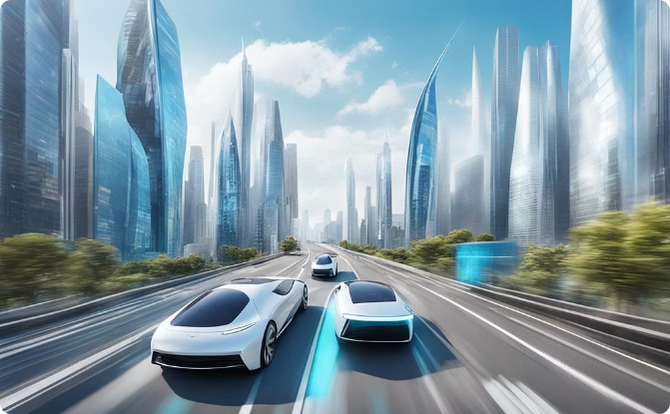
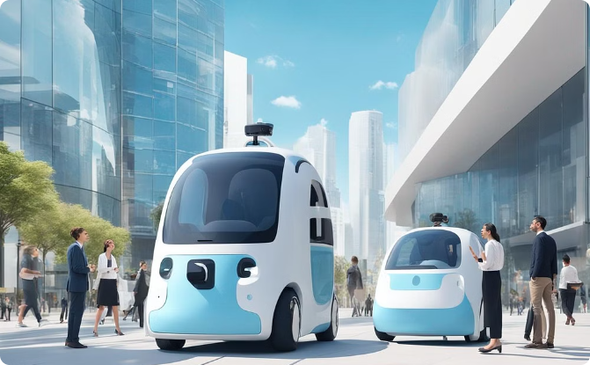
Coclusion
Efficient Urban Navigation
Public Trust and Safety
Autonomous vehicles showcase smooth and efficient movement through urban traffic, enhancing overall city mobility.
Public interaction with autonomous vehicles conveys trust and safety, contributing to acceptance and integration.
12

Slide 15
Thank You
13

